Slide 1
3D Interactive Media Development
5MMCS007W Lecture 01a
Intermission – 3D Examples
https://uowdigital.padlet.org/fergusj/web-web3d-and-web3-ecosystem-9xv91ovkasaaviua
https://uowdigital.padlet.org/fergusj/3dimd-cw-samples-5ohcvanq1wlcq0h9
Notes:
https://www.youtube.com/watch?v=id86HeV-Vb8
Example of fully Immersive Virtual Environments with 3D input

Slide 2
3D Interactive Media Development
Lecturers
Jeff Ferguson (Module Leader) Lectures Tuesdays 11:00-13:00
Tutorials Tuesdays 14:00-16:00, 16:00-18:00
Email: j.ferguson@westminster.ac.uk
Office Hours: Tuesdays 10:00-11:00, 13:00-14:00
Appointments by email request
Please contact for module related issues
Pumudu Fernando (IIT Module Delivery)
Email: pumudu.f@iit.ac.lk
Office Hours: email for contact
Notes:
Jeff Ferguson - Lectures, Tutorials, Module Leader
Email: j.ferguson@westminster.ac.uk
Lectures Fridays 9:00-11:00
Tutorials Fridays 11:00-13:00, 14:00-16:00
Office Hours: Fridays 13:00-14:00, 16:00-17:00, Appointments by email request
Hari Konda Ramamoorthy - Tutorials
Email: h.kondaramamoorthy@westminster.ac.uk
Tutorials Fridays 11:00-13:00

Slide 3
3D Interactive Media Development
Proforma Overview:
This module introduces students to concepts of 3D user interfaces
and 3D animated and interactive media. It covers essential topics
including 3D modelling principles, methods and techniques,
complex 3D objects creation, deformation and transformations,
texture mapping methods, colour and lighting. It uses an industry
standard games engine to demonstrate 3D animation concepts,
properties, controllers and scripting to create 3D animated,
interactive media content.

Slide 4
3D Interactive Media Development
Learning Outcomes:
LO1: Demonstrate an applied understanding of 3D modelling concepts and the
underlying geometrical principles and apply appropriate techniques and tools to
create 3D interactive media;
LO2: Incorporate 3D content in an industry standard games platform/engine;
LO3: Demonstrate an applied understanding of 3D animation concept, properties,
controllers and use of scripting techniques to create in 3D animation;
LO4: Demonstrate an applied understanding of scripting techniques to incorporate
interactive behaviours on 3D concept;
LO5: Work individually, as well as an effective team member to develop a common 3D
interactive media product;
LO6: Communicate design concepts by oral and visual means and provide documentation for
a 3D interactive media product in written form.

Slide 5
3D Interactive Media Development
Module Aims:
L5-M-LO1-MC - Specify, design, develop and test IMPs to solve real-life
medium-scale problems with appropriate techniques.
L5-M-LO5-CS - Demonstrate competency in object-oriented design and
algorithmic and mathematical approaches to solve medium scale problems.
L5-P-LO3-MC - Produce assets for the development of an IMP through
appropriate professional digital content creation, following an object oriented
approach.
L5-P-LO8-CS - Utilise, compare and contrast software frameworks and
architectures and implement solutions using object-oriented programming.
L5-D-LO6-MC - Employ a standard process such as storyboarding to design,
represent and formally communicate the specification of an IMP.

Slide 6
3D Interactive Media Development
Module Aims Continued:
L5-D-LO4-CS - Employ a standard design language for the design, representation and
formal specification of software.
L5-O-LO7-MC - Explain the life cycle of IMPs in the constraints of its operating technical
environment.
L5-O-LO7-CS - Explain the basic principles of modern operating systems and how they
serve operational needs.
L5-S-LO11-MC - Demonstrate professional responsibility in the development of quality
interactive media solutions in a global context and the presentation and defence of these
in multiple communication forms, supported by methodical research.
L5-S-LO10-CS - Demonstrate professional responsibility in the development of quality
computer science solutions in a global context and the presentation and defence of these
in multiple communication forms, supported by methodical research.

Slide 7
3D Interactive Media Development
Coursework (Group work)
Coursework 1 - Assesses the student skills in working as a team to plan and visualise a given 3D interactive media concept that addresses specific technical requirements, translate these into a practical sequence and compose the required 3D scene and content (the content will be later animated and interactive by adding appropriate behaviours to it) using industry standard tools. In addition, it assesses the student’s skills presenting and communicating their design concept efficiently. (Learning outcomes 1, 2, 5, 6)
Coursework 2 - Assesses the student practical ability to use appropriate scripting language to create required animation and interactivity to a proposed 3D interactive media product. In addition, it assesses the student’s skills documenting their implementation in a report using a professional style and their entrepreneurial skills by the creation of a working video demo of their project. (Learning outcomes 3-6).

Slide 8
3D Interactive Media Development
Coursework (Group work)
Note: – Groups will consist of equal numbers of CS, DM, CG, and other students. This has worked well in the past to play to each others strengths and also facilitate knowledge transfer.
Special Note: – This means your groups will not be in your tutorial sessions. This is normal, and does not affect your ability to plan and work together. Tutorials are for individual development. Group work is to be done outside of tutorials as part of “independent study”. All proformas indicate hours of independent study are required to complete the module outside of the normal lecture and tutorial time. The hours for independent study are normally more that those of lectures and tutorials combined, and are seen as the only way to complete the module successfully. The independent study hours for this module are as follows:
Lecture: 24
Tutorial: 24
Module and course based general study: 104
Preparation for assessment: 48
Total outside of class: 152 ! (This is what we look for in marking)

Slide 9
3D Interactive Media Development
Assessment criteria:
The student will demonstrate achievement of the learning outcomes by being able to:
Compose a 3D interactive media product following given technical requirements
without restricting creativity;
Using appropriate tools and scripting language to create 3D animated, interactive media content, smoothly integrate it in a 3D interactive media product and deploy it for multiple platforms and devices;
Demonstrate professional behaviour in identifying roles, delegating tasks to group members, recognising obligations, working individually, as well as a member of a team, in the development of a quality assured solutions to a medium scale interactive media product;
Communicate design concepts by oral and visual means;
Write documentation of a 3D interactive media product.

Slide 10
3D Interactive Media Development
Assessment Methods and Weighting:
Assessment name | Weighting % | Qualifying mark % | Qualifying set | Assessment type (e.g. essay, presentation, open exam or closed exam)
Group coursework 1 – 3D modelling and composition | 50 | 30 |  | Formative, Coursework (3D interactive media product), presentation
Preparation for Assessment |  |  |  | 24hrs
Group coursework 2 – 3D animation and interactivity | 50 | 30 |  | Coursework (3D interactive media product), report (800 words)
Preparation for Assessment |  |  |  | 24hrs

Slide 11
3D Interactive Media Development
Assessment criteria:
To achieve higher marks, students must demonstrate a greater degree of expertise and knowledge, and in particular to demonstrate knowledge of economic programming skills,
creative skills, as well as the ability to effectively work in a group.

Slide 12
3D Interactive Media Development
Marking:
70 or above : Work which shows exceptional effort, meeting all the requirements, but also demonstrates understanding and work beyond topics covered in class.
60 – 70 : Work which demonstrates considerable effort, meeting all the requirements, but not going beyond topics covered in class.
50-60 : Work which demonstrates some effort, and meeting most of the above requirements, or meeting requirements with little effort or understanding.
40-50 : Work which does not demonstrate great effort, and meets only a few of the above requirements, or meets most but with extremely poor effort and understanding. Work which is borderline in terms of suitability for submission.
Below 40 : FAIL - Work which has not been adequately attempted, demonstrates little effort and an insufficient understanding.

Slide 13
3D Interactive Media Development
Areas to ensure for CW:
Research, Design and Planning
Methodology and Management
Implementation and Deployment
Analysis and Evaluation
Assessment:
Video Presentations submitted to Blackboard
Presentations and Discussions in class
Peer Review in video and in class

Slide 14
3D Interactive Media Development
Penalty for Late Submissions:
Coursework submitted up to 24 hours late will receive a deduction of 10 marks.
Coursework submitted after 24 hours will receive a mark of zero.

Slide 15
3D Interactive Media Development
Mitigating Circumstances:
If you are unable to submit your coursework or attend an assessment due to unforeseen, unpreventable, serious circumstances you may be eligible to claim for Mitigating Circumstances.
The University operates a ‘fit to sit’ policy which means if you submit a piece of coursework or sit an exam and/or in class test, you have deemed yourself fit to do so. You cannot submit a claim for mitigating circumstances in this case.
Claims should be submitted as close to the deadline for the item of work as possible. Please follow the guidelines and complete the MC form fully, this helps the Registry in administering your claim correctly and efficiently.
Unfortunately, claims with missing information may not be considered and may have to be returned to you.

Slide 16
3D Interactive Media Development
Academic Misconduct - Plagiarism, Collusion:
Can result in a Zero or Suspension
https://www.westminster.ac.uk/study/current-students/resources/academic-regulations/academic-misconduct

Slide 17
3D Interactive Media Development
Syllabus:
3D User Interfaces (UIs) and interaction styles:
introduce applications of 3D UIs, video gaming, large displays, mobile applications, etc. Discuss principles of designing Usable 3D UIs. Understand the design space.
3D world representation and 3D space transformation
Key concept of 3D modelling, primitives:
polygonal mesh representation (vertices, edges, faces), creating and editing a scene from primitives, polygon editing, parametric curves, NURBs and spline-based modelling concepts, lathing, extruding and Boolean modelling techniques to create complex models groups and hierarchies, construction history.

Slide 18
3D Interactive Media Development
Syllabus:
Understanding Visual effects, shading (composing and colour grading), texturing mapping (UV texture layout, coordinates, mapping) and paint effects. Brief introduction to lighting (illumination model, light types and properties) and shading (mental ray shading).
Preparation for animation, basic skeletons (not full body character) and basic rigging techniques (not to the extent of character animation).
Animation techniques, timeline based animation; motion paths; basic relationships: constraints, set driven keys. Standard 3D UI for 3D interactive games engines.
Interactivity, control a 3D geometry and animation properties with the use of appropriate scripting language.
Current 3D UI Research.

Slide 19
3D Interactive Media Development
Schedule: Schedule 3DIMD 2025.docx

Slide 20
Padlet with Examples!
CW Details, Previous CW, Real world examples
https://uowdigital.padlet.org/fergusj/3dimd-cw-samples-2025-1f4w3m19lc80m9cf

Slide 21
Mobile Learning – iPads, Devices, Web
Powerpoint
Lectures
BB Panpoto
Video
Lectures
Padlet,
Excel Sheets
Group Work
Always Use University
Email Accounts for access,
If denied access on learning documents or platforms, this is likely the cause, try switching web browser logins to Uni email.
1
2
3
On Blackboard
Ultra
University Outlook
Account Login
On Blackboard
Ultra
University Outlook
Account Login
On Blackboard
Ultra:
Discussion, Padlets, Discord
University MS
Account Login
Group Work
Video Presentations
Peer Review

Slide 22




Further Reading List and Reference
3DUI
3DUI Research
3DSMax
Unity3D
C#

Slide 23
Further Reading List and Reference
3DUI
3DUI:Theory and Practice
eBook in Library
Reading List in BB
THIS IS THE KEY TEXT, YOU SHOULD ALL READ THIS: (Doug Bowman is now head of AR/VR at Apple)
Title: 3D User Interfaces: Theory and Practice
Author: Doug A Bowman
Publisher: Addison-Wesley Professional
Identifier: ISBN0-13-339059-4
Creation Date: 2004
Language: English
Source: infoLinX infoLinX

Slide 24
Further Reading List and Reference
3DUI
Conference and book
Research Journal Link-Library
Conference
https://people.cs.vt.edu/bowman/3dui.org/Home.html
Committee Resource:
This has some key summaries of the book in the Resources
http://people.cs.vt.edu/~bowman/3dui.org/Home.html
http://people.cs.vt.edu/~bowman/3dui.org/Resources.html
Journal
Title: 2016 IEEE Symposium on 3D User Interfaces (3DUI)
Publisher: IEEE
Creation Date: 2016
Language: English
Source: infoLinX
Microsoft
https://www.autodeskresearch.com/projects/3dnav

Slide 25
Further Reading List and Reference
Online Autodesk Tutorials
http://help.autodesk.com/view/3DSMAX/2017/ENU/?guid=GUID-68FFEEDA-3801-444E-B450-942E03A7523D
Pluralsight, Digital Tutors (Try temporary License)
Lynda.com (now Linkedin)
(University now has subscription)
Module Tutorial Sheets
Lego Man
https://www.youtube.com/watch?v=u9wghSWKf-c
3DSMax
Box Modelling
https://www.youtube.com/watch?v=3ZuLmd9OSYc
Edge Modelling
https://www.youtube.com/channel/UClFsEsF33aNadnLUn-tqpRQ
Pivots
http://www.aclockworkberry.com/world-coordinate-systems-in-3ds-max-unity-and-unreal-engine/
Procedural work
https://www.pluralsight.com/courses/procedural-generation-3ds-max-2080#play-49466%E2%80%8B

Slide 26
Further Reading List and Reference
Tutorials Point
http://www.tutorialspoint.com/csharp/
MSDN
http://www.microsoftvirtualacademy.com/training-courses/c-fundamentals-for-absolute-beginners
Head First C#
https://github.com/head-first-csharp/fifth-edition
C# Programming Yellow Book http://static1.squarespace.com/static/5019271be4b0807297e8f404/t/55e8091ee4b0b7a615665de5/1441270046307/CSharp+Book+2015+Final.pdf
Youtube
https://www.youtube.com/playlist?list=PL_eGgISVYZkdtClbuMbZqlNJ-xLo_OTwc
Lynda.com/ Linkedin
(University now has subscription)
Pluralsight, Digital Tutors (Try temporary License)
Packt C#, Unity Scripting
https://www.packtpub.com/
C#

Slide 27
Further Reading List and Reference
Unity Hub/Unity Learn
(Gameplay Scripting, Rollaball)
https://unity.com/learn
https://unity3d.com/learn/tutorials/topics/scripting
Learn Unity
https://learn.unity.com/
Unity UI Tutorials https://unity3d.com/learn/tutorials/topics/user-interface-ui
Wiki.Unity3D.com
http://wiki.unity3d.com/index.php/Main_Page
Unity Manual
https://docs.unity3d.com/2023.2/Documentation/Manual/index.html
Packt Publishing
https://www.packtpub.com/
Youtube Ctrl Alt Del https://www.youtube.com/channel/UClFsEsF33aNadnLUn-tqpRQ
Youtube BergZurg
https://www.youtube.com/channel/UCOIcO8Lsk1MERedhOnew73A
Pluralsight, Digital Tutors (Try temporary License)
Lynda.com (University now has subscription via Linkedin)
Module Tutorial Sheets
Unity3D

Slide 28


Further Reading List and Reference
Experience Survey UOW Only: >>>
https://uowdigital.padlet.org/fergusj/3dimd-intro-2025-uow-b51inegc8wf3wwc1
Experience Survey IIT Only: >>>
https://uowdigital.padlet.org/fergusj/3dimd-intro-2025-iit-7uspoqpdrfcpk107

Slide 29


Workflow – 3DUI for Interactive VE*
*Virtual Environment
Fbx
3DS Max
Modelling
Texturing
Fbx
WebGL
Chrome or Firefox Keyboard Input Mouse Input
Unity3D
Shaders
Lighting C# Interaction
C# Navigation C# System States

Slide 30
Virtual Environment – 3DUI Needed
At its most basic, we need some sort of 3D UI to interact with a Virtual Environment.
We may think we know instinctively what a VE is, but to correctly define and use 3D UI concepts, we must know what flavour of VE we are using or need.
This is complicated greatly by public perceptions of VEs and the misnaming and misconceptions that happens.

Slide 31
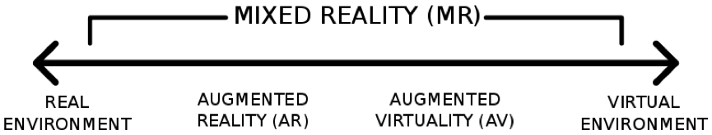
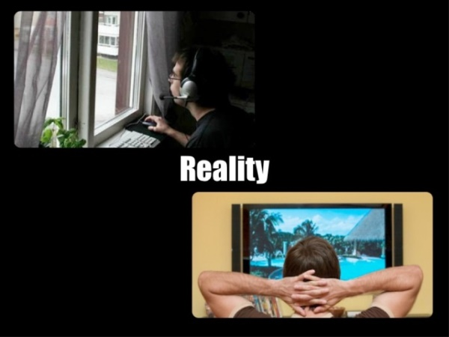
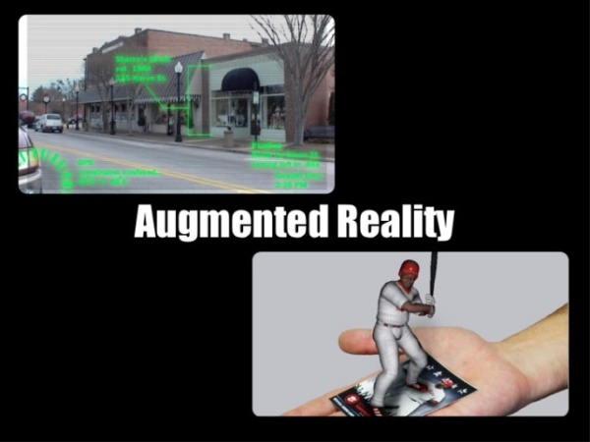
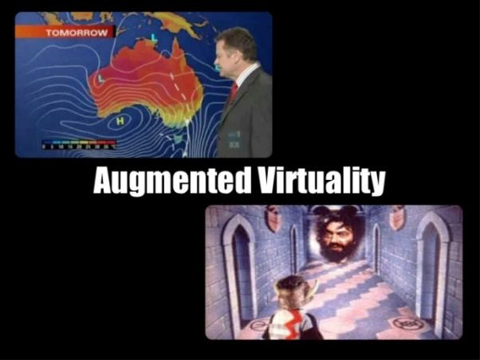
Basic - Mixed Reality Scale

Slide 32
Basic – VE Permutations – Part 1
Real world examples
https://uowdigital.padlet.org/fergusj/3dimd-cw-samples-5ohcvanq1wlcq0h9
VR Platforms
https://padlet.com/sselwood1/VirtualMeeting
XR In Industry
https://uowdigital.padlet.org/fergusj/XRinIndustry
XR Lab Website
XR Lab on Blackboard
XR Lab Examples
XR Lab Demo Videos
…and some misnomers
Holograms - No
Virtual Reality (360 Video)

Slide 33
3DUI VR
Immersive (VR) Journalism
Fishtank VR - Google Cardboard 6 x 9
https://www.theguardian.com/world/ng-interactive/2016/apr/27/6x9-a-virtual-experience-of-solitary-confinement
Desktop VR – Harvest of Change
http://www.desmoinesregister.com/story/money/agriculture/2014/09/17/harvest-of-change-virtual-farm-virtual-reality/15785377/
Syrian Prison
https://saydnaya.amnesty.org/
360 Image/Video w/ 3DUI
HoloBuilder https://www.holobuilder.com/
VR with POV
BBC Taster http://www.bbc.co.uk/taster/
VR with 3D Input
Vive Job Simulator http://jobsimulatorgame.com/
Ikea VR https://www.youtube.com/watch?v=1S0GO5kbMYo
Vive Tilt Brush https://www.youtube.com/watch?v=aocLCCvJTBU
https://www.youtube.com/watch?v=GSbkn6mCfXE
Notes:
Spatial.io
Hyperfy
Hytopia session - (Roblox Style Modding)
New Art City Session for groups (at beginning?)
8th Wall Niantic
OnCyber

Slide 34
3DUI New Platforms
Larger Recent Ecosystem:
https://uowdigital.padlet.org/fergusj/web3d-and-web3-ecosystem-9xv91ovkasaaviua
Web3D (WebGL/GPU)
WebXR
Includes WebRTC, WebVR, WebAR and other openprotocols and file formats
Web3 – tokenisation allowing for self-publishing and interoperability on above protocols

Slide 35
References
3D User Interfaces: Theory and Practice
Doug A. Bowman, Ernst Kruijff, Joseph J. LaViola, Ivan Poupyrev
Addison Wesley Longman Publishing
USA https://people.cs.vt.edu/~bowman/3dui.org/CHI_2008.html
The Three-Dimensional User Interface
Hou Wenjun
Beijing University of Posts and Telecommunications
China https://cdn.intechopen.com/pdfs/5463/InTech-The_three_dimensional_user_interface.pdf

Slide 36
Group Formation
Groups of 4-5 Students YOU WILL BE ASSIGNED TO GROUPS IN YOUR TUTORIAL
Tutorials for first 4 weeks are Unity basics for CW1
CW1 is the start and planning for an IMP (Interactive Media Product)
CW2 is the completion of an IMP (Interactive Media Product)
Group Assignment
Start talking about Idea/Problem and general design
3D GUI, Navigation, Interaction, States, Animation
Lego brainstorm – Virtual or Real
Think about Peer Review and Assessment
Video review
Connoisseurship practice

Slide 37

Group Brainstorm
Assemble in your group
Group Activity
Explore ideas online
Start to negotiate ideas (not final)
Lego brainstorm –
Build diorama with negotiated ideas
Photograph, Submit and Share
Take Photos, add notes and publish to padlet (UOW)
https://uowdigital.padlet.org/fergusj/2025-3dimd-brainstorm-3igzgiru8o4neldo

